Slide 1
ASSIGNMENT #3
Measures of Dispersion

Slide 2
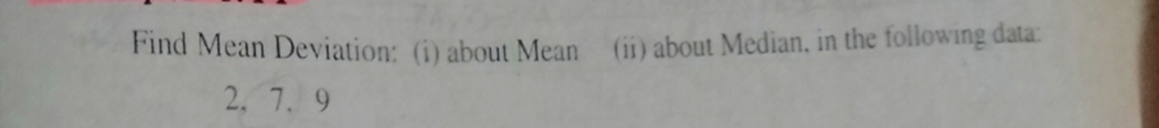
Mean Deviation
Compute Mean Deviation about “mean” of the following data

Slide 3
Function
function [] = M.D(X)
end

Slide 4
Output of Mean Deviation

Slide 5
Mean Deviation
Compute Mean Deviation about “median” of the following data

Slide 6
Function
function [] = M.D(X)
end

Slide 7
Output of Mean Deviation about median

Slide 8
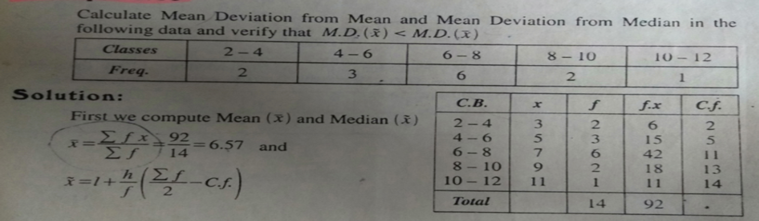
Grouped Mean Deviation
Compute Mean Deviation of the following data

Slide 9
Grouped Function
function [] = Grouped_M.D(X)
end

Slide 10
Output of Grouped Mean Deviation

Slide 11
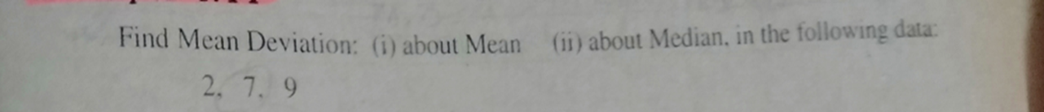
Co-efficient of Mean Deviation
Compute the Co-efficient of Mean Deviation of the following data

Slide 12
Function
function [] = Co_M.D(X)
end

Slide 13
Output of Co-efficient of Mean Deviation

Slide 14
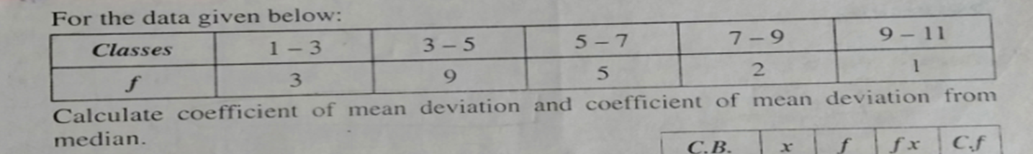
Grouped Coefficient of Mean Deviation
Compute Coefficient of Mean Deviation of the following data

Slide 15
Grouped Function
function [] = Co_M.D(X)

Slide 16
Output of Grouped Co-efficient of Mean Deviation

Slide 17
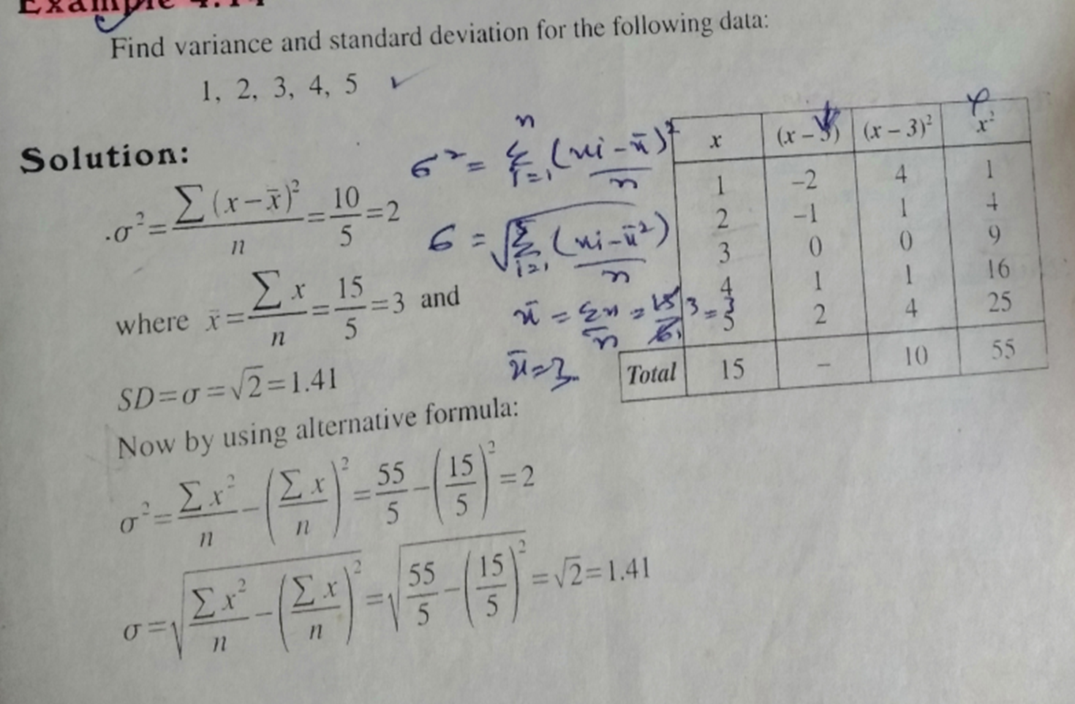
Variance and Standard Deviation
Compute Variance and Standard Deviation of the following data

Slide 18
Function
function [] = V.S.D(X)

Slide 19
Output of Variance and Standard Deviation

Slide 20
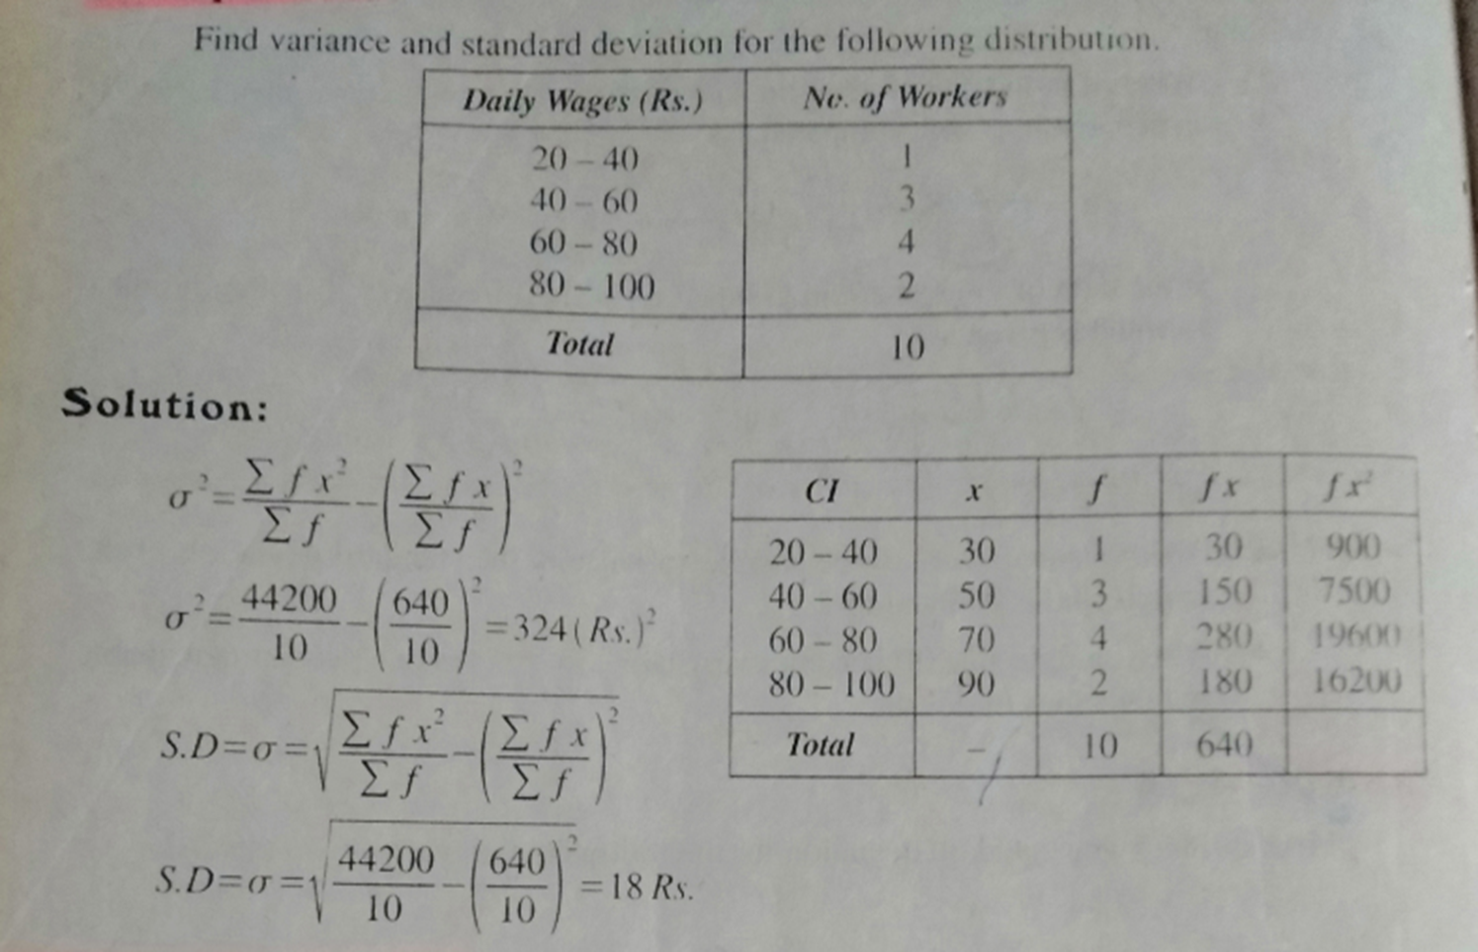
Grouped Variance and Standard Deviation
Compute Variance and Standard Deviation of the following data

Slide 21
Grouped Function
function [] = Grouped_V.S.D(X)

Slide 22
Output of Grouped Variance and Standard Deviation

Slide 23
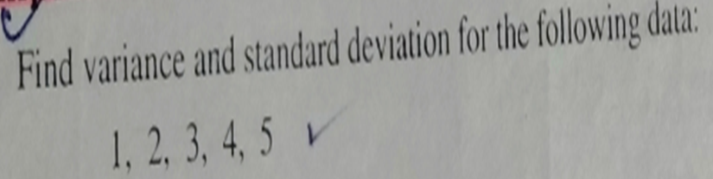
Co-efficient of Variation
Compute the Co-efficient of Variation of the following data

Slide 24
Function
function [] = Co_V.S.D(X)

Slide 25
Output of Co-efficient of Variation and Standard Deviation

Slide 26
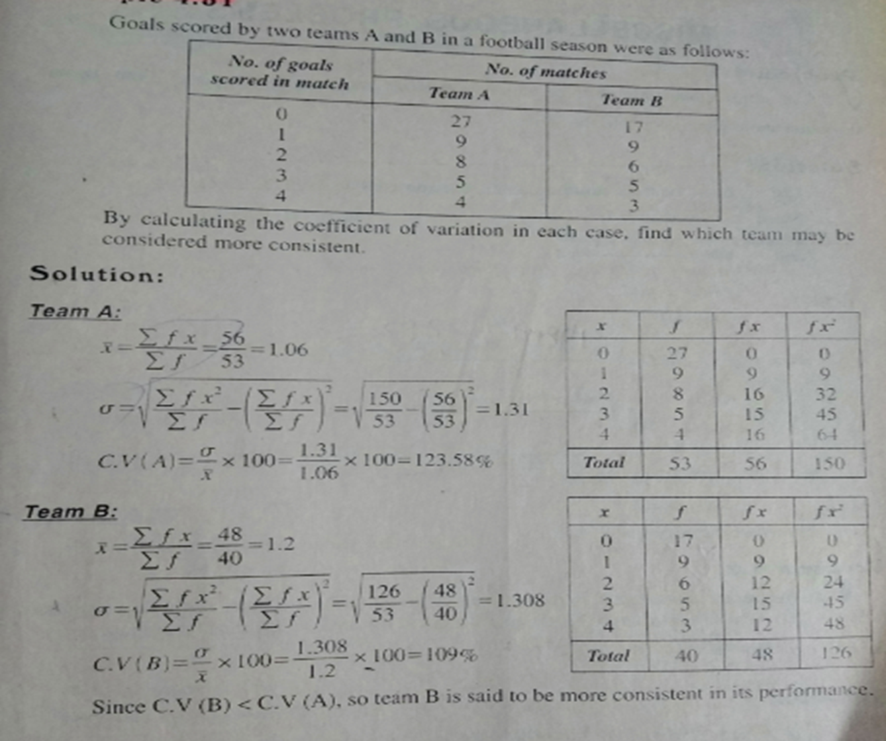
Grouped Coefficient of Variance and Standard Deviation
Compute Coefficient of Variance and Standard Deviation of the following data

Slide 27
Grouped Function
function [] = Co_V.S.D(X)

Slide 28
Output of Grouped Co-efficient of Variation and Standard Deviation

